Slide 1


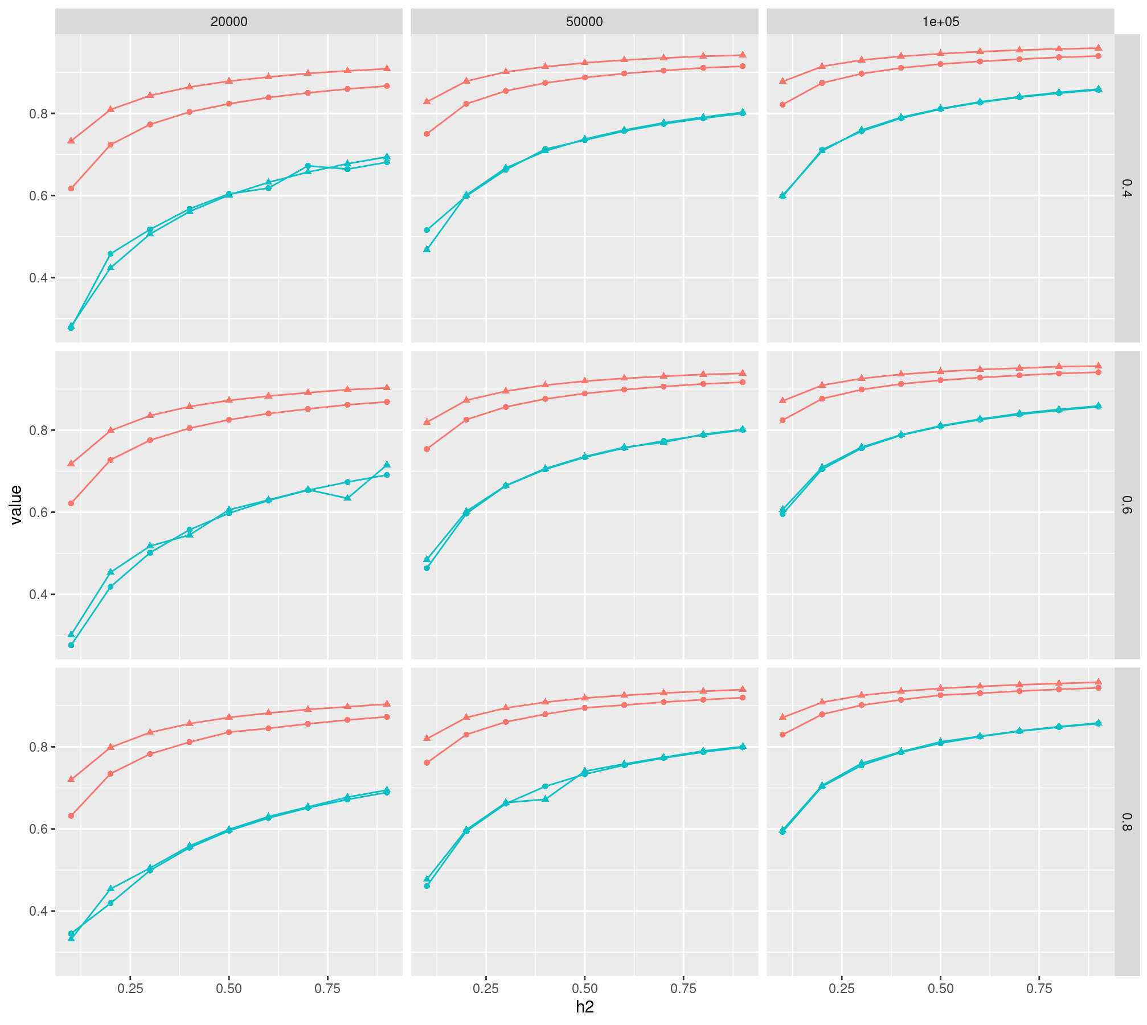
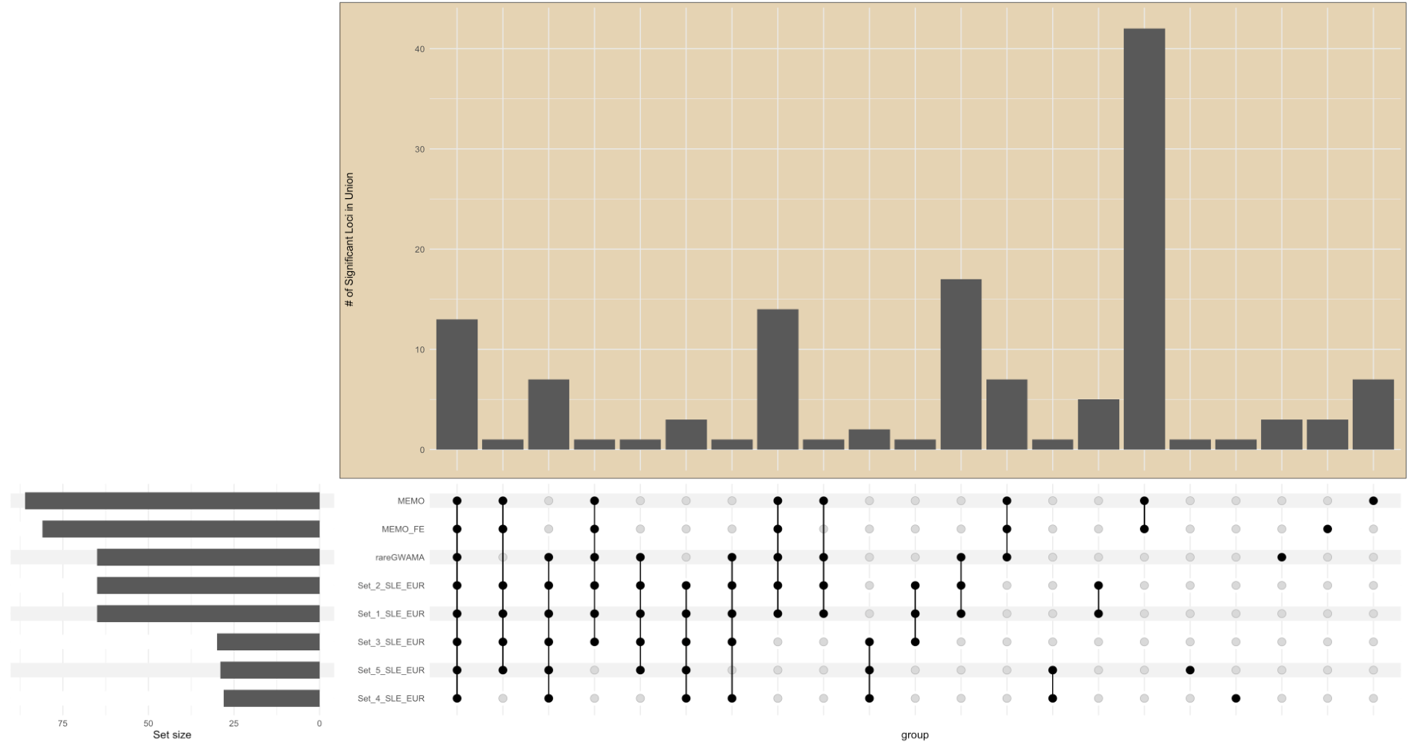
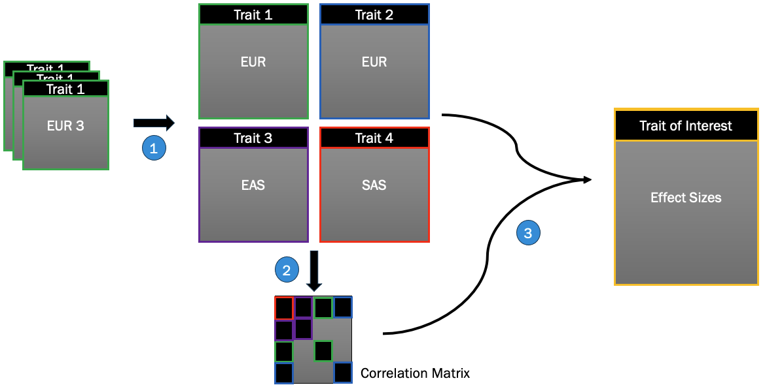
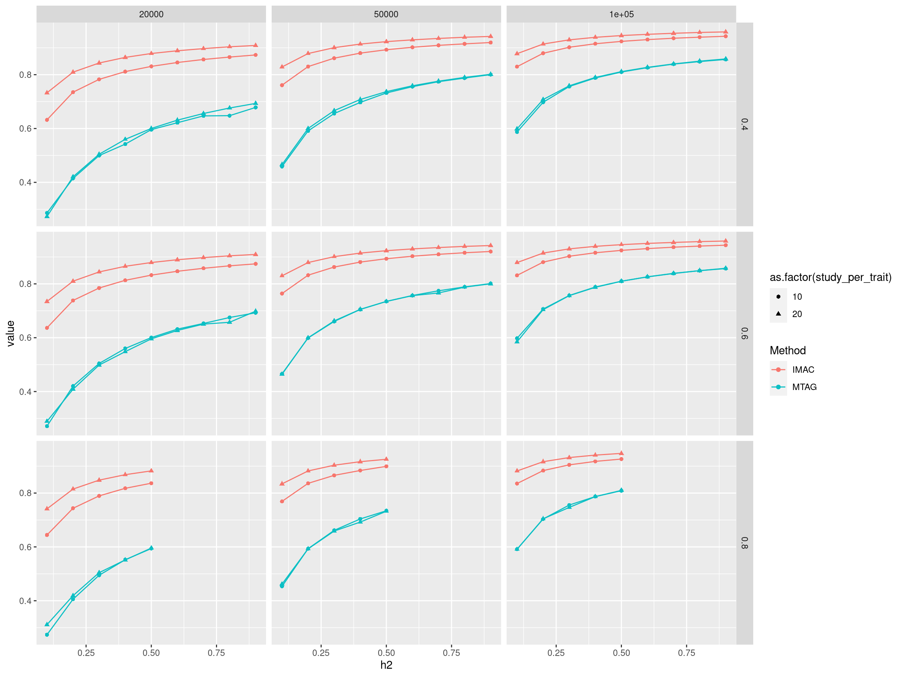

















Multi-Trait, Multi-Ancestry Meta-Analysis of Autoimmune Diseases
Keenan Anderson-Fears^{1,2}, Dr. Xingyan Wang², Dr. Dajiang Liu^{1,2}
1) Huck Institute of Life Sciences, 2) Department of Public Health Sciences, Penn State
Overview
Correlation Matrix
Power Missing
Meta-analyses have often been performed under the assumption that a given trait and ancestry are either independent or share little information with other traits and ancestries. However more recent advancements have shown the wealth of information available for including multiple traits or multiple ancestries with no current methods available for the inclusion of both. Here we propose and demonstrate the effectiveness of our new model IMAC, which through the use of summary statistics and a genetic correlation matrix, performs a maximum-likelihood-based multi-trait, multi-ancestry meta-analysis using a variable number of principal components and a p-value cutoff to calculate residual correlation.
Purpose of Study
Variant Overlap Between Methods
To purpose and benchmark a new method for meta-analysis capable of combining multi-trait and multi-ancestry summary statistic data
IMAC vs popcorn-MTAG Hybrid
Why?
Combine similar ancestry, similar trait studies via rareGWAMA
Calculate genetic correlation matrix between all studies (popcorn)
Run meta-analysis on clustered studies based on correlation matrix (MTAG)
Diseases can share genetic and environmental precursors
Systemic Lupus Erythematosus has been previously shown to share associations with other autoimmune diseases (Choi, M. and Costenbader, K., 2022.)
Ancestral differences in allele frequency make causal variant detection difficult
Availability of large genome-wide association studies (GWAS) offers a great opportunity to use genetic data from multiple diseases and ancestries
Current methods are limited to multi-trait or multi- ancestry analyses, not both
MDS techniques are frequently used to capture ancestral variability
Power: MTAG vs IMAC
IMAC Outperforms MTAG
IMAC
Better controlled T1E (Figure 5)
Greater statistical power (Figure 3)
Greater power across traits (Figure 6)
8/10 correlation sets compared to MTAG (Figure 4)
6/10 correlation sets compared to MEMO (Figure 4)
IMAC extension borrows strength across correlated traits and ancestral populations using genetic correlations, ancestral principal components, random effects, and error:
$$β_{j,k}=\sum_{l}{Z_{kl}γ_{js}}+ \sum_{l}{Z_{kl}^{∗}γ_{js}^{∗}}+e_{j}+ε_{j}$$
$β_{jk}$: effect size estimate
$Z_{kl}γ_{js}$: genetic correlation
$Z_{kl}^{∗}γ_{js}^{∗}$: ancestry specific effect
$e_{j}$: random effects
Genetic Correlation Matrix:
$$P={\left(ω_{st}\right)}_{kXk}$$
Test Scenarios:
$$H_{0}:γ=γ^{∗}=0$$
$$H_{0}:Z_{k}γ_{j}+Z_{k}^{∗}γ_{j}^{∗}=0→\left(Z_{k} Z_{k}^{∗}\right)\left(\begin{matrix}γ_{j} \\ γ_{j}^{∗}\end{matrix}\right)=0$$
$$H_{0}:Z_{k}γ_{j}=0→\left(Z_{k} 0\right)\left(\begin{matrix}γ_{j} \\ γ_{j}^{∗}\end{matrix}\right)=0$$
Number of Unique Loci
IMAC Identifies More Loci
 | Set | MEMO | MEMO_FE | MTAG | IMAC
NPC |  |  |  |  | 1 |  |  | 3
P-Value Cutoff |  |  |  |  | 0.05 | 0.1 | 0.2 | 0.05 | 0.1 | 0.2
SLE European | 1 | 88 | 84 | 61 | 57 | 57 | 57 | 53 | 53 | 53
 | 2 |  |  | 61 | 78 | 78 | 81 | 56 | 56 | 56
 | 3 |  |  | 30 | 101 | 104 | 105 | 66 | 66 | 66
 | 4 |  |  | 28 | 118 | 122 | 127 | 91 | 91 | 92
 | 5 |  |  | 29 | 120 | 124 | 134 | 92 | 93 | 95
SLE East Asian | 1 |  |  | 27 | 61 | 62 | 62 | 29 | 29 | 29
 | 2 |  |  | 27 | 59 | 61 | 62 | 34 | 35 | 35
 | 3 |  |  | 15 | 100 | 101 | 103 | 79 | 79 | 80
 | 4 |  |  | 15 | 104 | 108 | 112 | 87 | 90 | 89
 | 5 |  |  | 15 | 110 | 112 | 115 | 91 | 90 | 91
What’s Next?
Construct genetic risk scores w/ various methods:
$$logit\left(\operatorname{Pr}\left(Y=1\right)\right)=β_{0}+β_{GRS}×GRS+{\overset{⃑}{X}}_{lab}{\overset{⃑}{β}}_{lab}+{\overset{⃑}{X}}_{covar}^{′}{\overset{⃑}{β}}_{covar}$$
Predict ILE to SLE by combining GRS models with clinical risk scores:
$$logit\left(\operatorname{Pr}\left(Y=1\right)\right)=β_{CRS}×CRS+β_{GRS}×GRS+X_{covar}^{′}{\overset{⃑}{β}}_{covar}$$
T1E
Threshold | IMAC | MTAG
5.00E-02 | 0.15579105 | 0.5392847
5.00E-04 | 0.0164019 | 0.3232037
5.00E-06 | 0.0024589 | 0.2314076
5.00E-08 | 0.00045065 | 0.1802694
Literature Cited:
Choi, M. and Costenbader, K., 2022.
Brielin C. Brown, Chun Jimmie Ye, Alkes L. Price, and Noah Zaitlen. 2016.
Patrick Turley, Raymond K. Walters, Omeed Maghzian, Aysu Okbay, James J. Lee, Mark Alan Fontana, Tuan Anh Nguyen-Viet, Robbee Wedow, Meghan Zacher, Nicholas A. Furlotte, Patrik Magnusson, Sven Oskarsson, Magnus Johannesson, Peter M. Visscher, David Laibson, David Cesarini, Benjamin M. Neale, and Daniel J. Benjamin. 2018.
Acknowledgments:
Dr. Xingyan Wang
Dr. Dajiang Liu
The Liu Group Lab
Lupus Foundation of America
National Institute of Health
Further Information:
https://dajiangliu.blog
Notes:
Copyright Colin Purrington (http://colinpurrington.com/tips/academic/posterdesign).

